Slide 1
Network Security
ACL / AAA
NS
Lecture03

Slide 2
Discussion of the first worksheet
Filesystem access control matrices?
Find at least 6 issues with these policy documents?
Identify ten vulnerabilities and assign a likelihood and a consequence. Solutions? (avoided , transferred , mitigated, or accepted)

Slide 3
Firewalls
Confidentiality - Network Access
Controls

Slide 4
What is a Firewall?
A firewall is a combination of hardware and software components that controls the flow of traffic from one network to another
In many cases a firewall is placed between an internal office network and an external public network such as the Internet
Both incoming and outgoing traffic can be controlled by the firewall
A firewall acts as a gateway or a filter between two networks, network segments or systems
Therefore it provides a unique opportunity to monitor and control the flow of traffic to and from a network

Slide 5
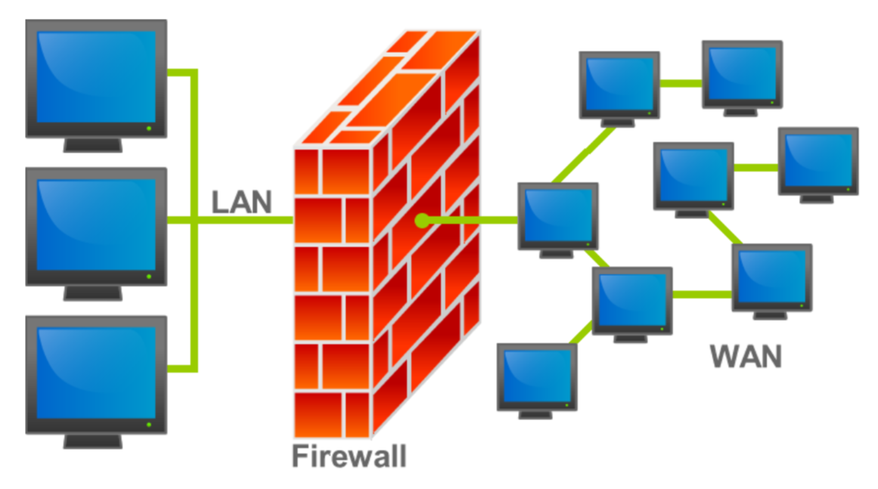
What is a Firewall?
Most firewalls are used to protect an internal network from the Internet

Slide 6
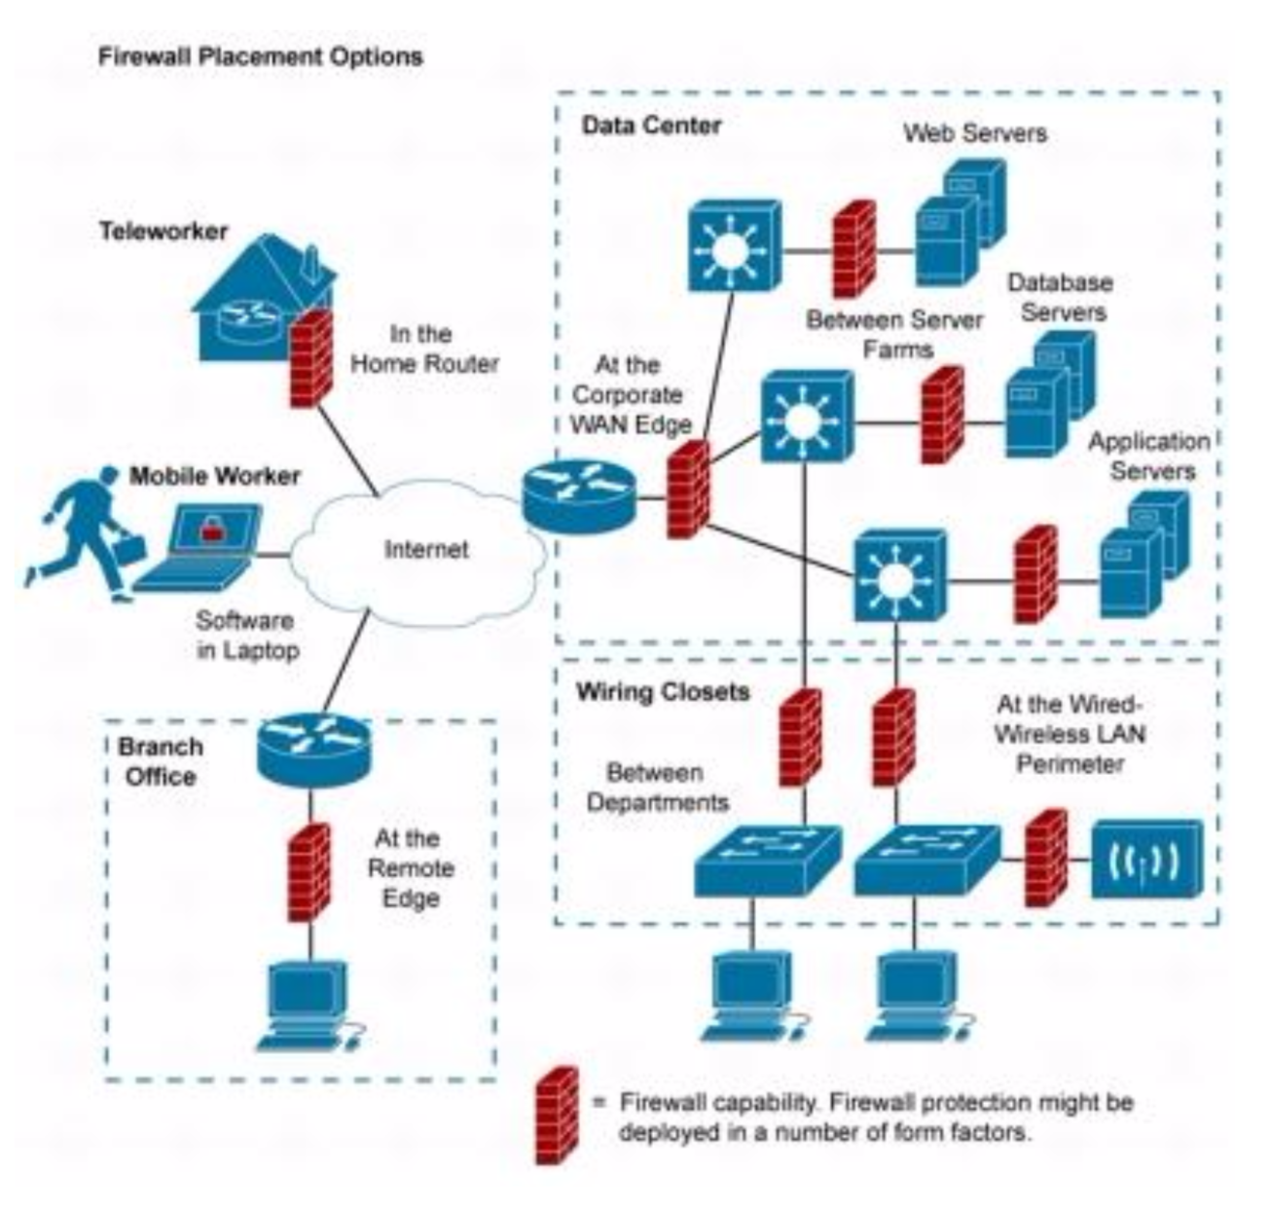
Also
But they can also be used to control traffic flow between any logical or physical network segment.
Cisco (who sell firewalls) suggest that a firewall is placed at every “trust edge”.

Slide 7
Security
Firewalls provide a focus for implementing security decisions:
–All traffic must pass through the firewall
–Traffic can be restricted in almost any way
–This is more efficient than filtering traffic on each client in the network
Firewalls can be used to enforce security policies
–only allows services which the administrators have approved to pass to and from the external network.

Slide 8
Security
Firewalls can efficiently log network activity
–all traffic passes through the firewall so it is the logical place to capture information about network use (and abuse)
Firewalls limit security exposure
–Firewalls are the single point of contact between the internal and external networks
–People on external networks can only see computers and services approved by administrators

Slide 9
What firewalls don’t do...
Inside Attacks
If an attacker already has physical access to an area within a firewall’s perimeter then that “zone” is vulnerable
However, a firewall’s ability to restrict outbound traffic may be enough to mitigate some threat.
Firewalls cannot prevent traffic that circumvents the device
Rogue access points
Unprotected routes

Slide 10
Reactive
Firewalls are for the most part reactive
-Rules are used to determine actions. You cannot write a rule for an event you do not know exists.
-Signature based detection requires....a signature. 0 day attacks, signature obfuscation.

Slide 11
So, how does it work?
A basic firewall is simply an access control device that determines access permissions based on a set of “deny” or “allow” rules provided.
Modern firewalls are capable of a lot more including:
-Network Proxy and Reverse Proxy
-NAC / Remediation
-Anti-virus / Anti-Malware / email filtering

Slide 12
AAA
Authentication
-users must be authenticated to access some or any resources inbound or outbound
Authorization
-More granular, users can be given or denied permission to or from certain addresses / resources and protocols
Accounting
-For internal billing or time/resource monitoring

Slide 13
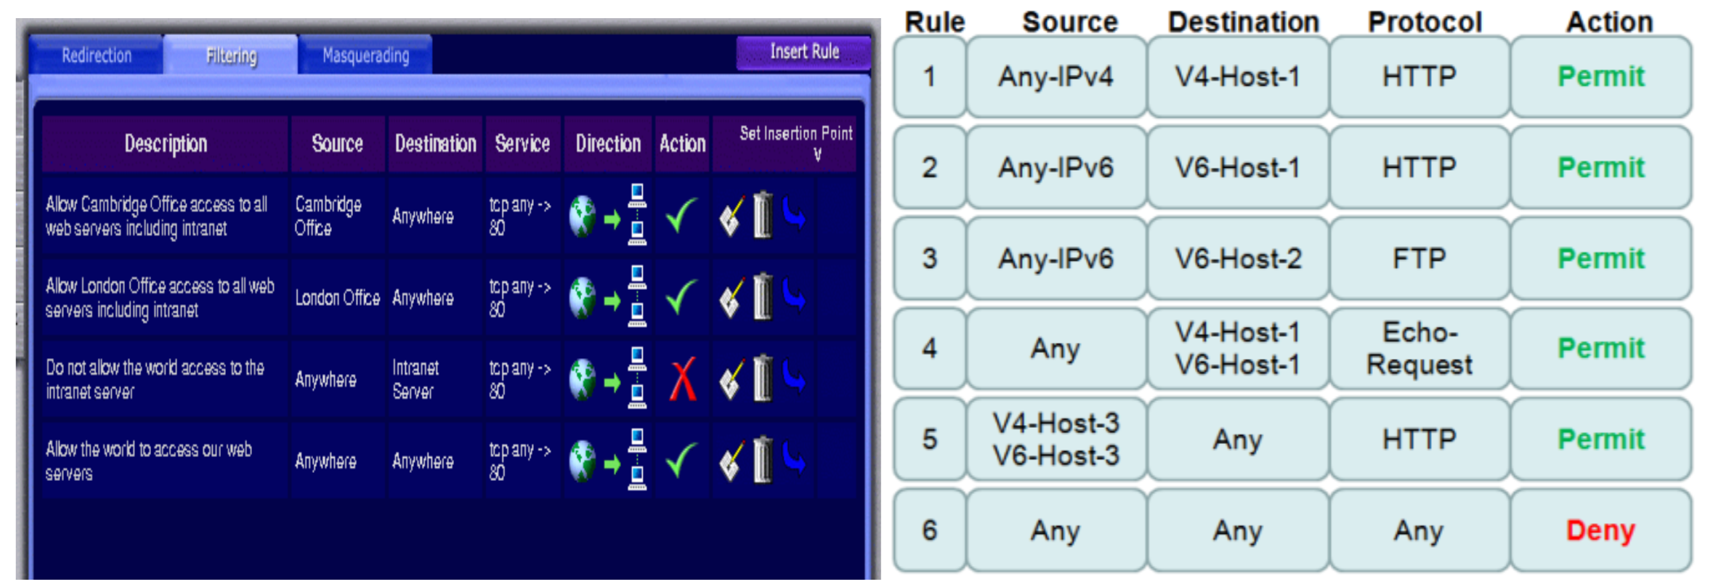
Access Rules

Slide 14
Inspection Rules
CBAC – Context Based Access Control
-Creates an open inbound channel for any outbound communication / SPI
-Inspects TCP sequence numbers and drops unexpected packets
-Enforces Timeout thresholds
-Some Protocols allow for DPI
-Inspection rules are only applied after Access Rules to avoid unnecessary workload.
Notes:
CBAC - intelligently filters TCP and UDP packets based on application layer protocol session information.

Slide 15
Web Filtering
URL based blacklisting
-Usually download URL categorisation lists from an external trusted source (pornography, gambling, hacking etc.)
Protocol / Connection Rules
-HTTP / FTP / HTTPS
-Inline Content filtering (ActiveX / Java applet / Javascript)
-URL pre-resolution to defeat URL-shortening

Slide 16
Zone based rules
Port groups and device groups are assigned to “zones”
-Intranet , extranet , DMZ , WAN, LAN, Database servers, Self (the router/firewall itself)
-Much more basic ruleset. Used for traffic shaping and management.

Slide 17
Botnet/Malware Filters
Signatures that identify malicious traffic
Known botnet behaviour and addresses
Known virus activity
Heuristic Analysis
Learns “normal” traffic behaviour
Blocks abnormal until admin allow or deny

Slide 18
Email Filtering
Act as mail gateway to automatically block or quarantine suspect emails
Signature or heuristic based
Level of acceptability set by the security admin

Slide 19
OSI Model
Firewalls act across multiple OSI layers depending on the features available
Layer 7 – Application aware Rules
Layer 6 – Encryption Bridgepoint/ Cert exchange (port group)
Layer 5 – MITM / Endpoint Proxy
Layer 4 – Sequence counting
Layer 3 – IP address filtering / DPI / SPI (default)
Layer 2 – NIC ID (MAC) filtering, Device type
Layer 1 – Physical connection

Slide 20
Architecture 1
Dual Homed (or more)
2 network cards
1 facing internally
1 external
Provides NAT / PAT capability
This is a single point of failure –no depth of defense

Slide 21
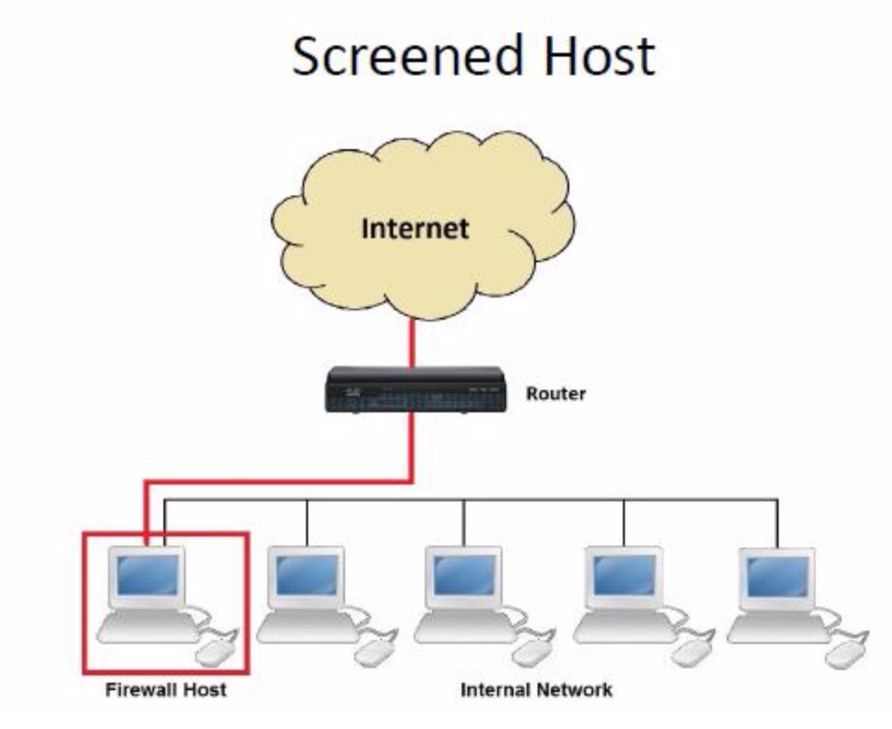
Architecture 2
Firewall Host and access point are separate
Inbound Traffic is routed to the firewall for rule matching
Outbound traffic is rule-checked and passed directly based on initial rules
Both devices are single point of failure but both need to be compromised for full exposure.

Slide 22
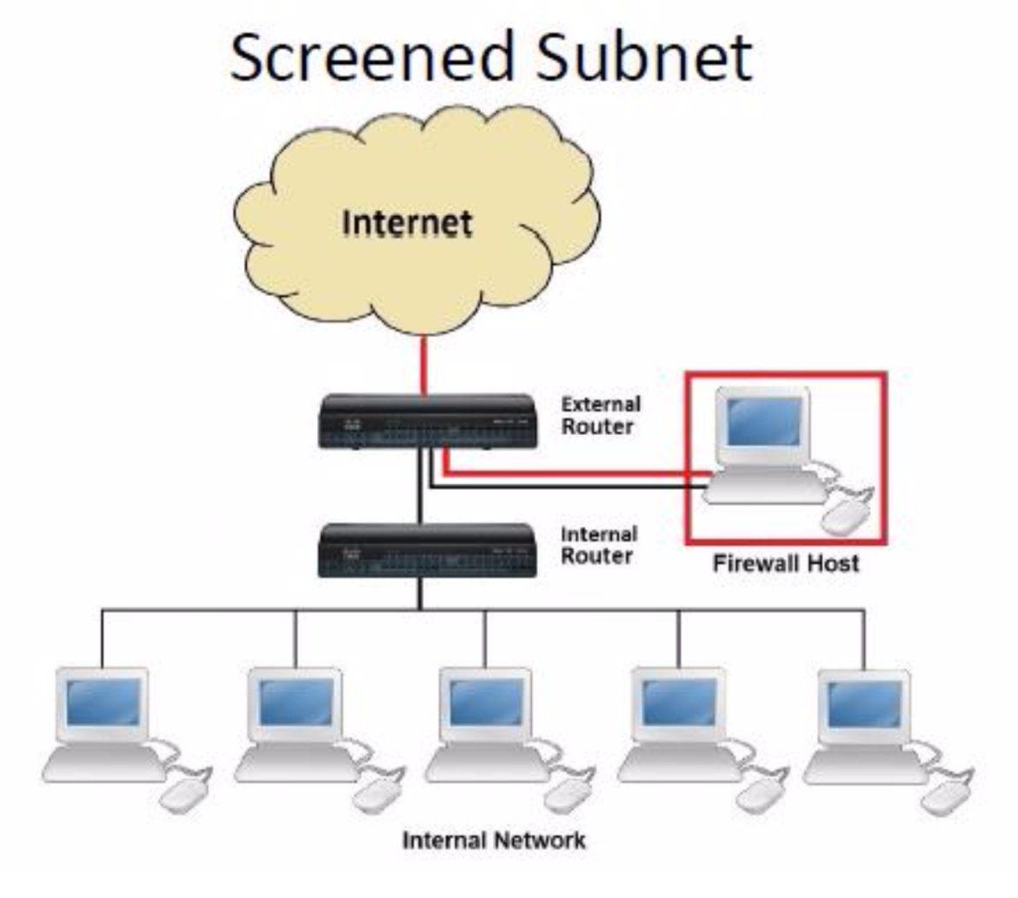
Architecture 3
Currently the most common application
Firewall sits in a DMZ.
Traffic rules route to the firewall for inspection
Firewall routes in or out depending on ruleset
Usually any server hosting an external service will be placed on the DMZ subnet
Also an option for NAC / Remediation rules

Slide 23
Break!

Slide 24
Kerberos
Designed to provide strong authentication for client/server applications by using secret key cryptography.
Provides authentication, authorization and auditing.
Primary goal is to provide private communications between systems on a network.
In managing the encryption keys it acts to authenticate each of the principles in the communication based upon possession of the secret key which allows access to the session key.

Slide 25
Kerberos 4 basic requirements
Security
against attacks by passive eavesdroppers and actively malicious users
Reliability
Resources must be available when needed
Transparency
Users shouldn’t notice authentication taking place
Scalability
Large number of users and servers

Slide 26
Kerberos process
XYZ Service
Key
Distribution
Center
Ticket
Granting
Service
Think “Kerberos Server” and don’t let yourself get mired in terminology.
Authen-
Tication
Service
Susan’s
Desktop
Computer
Susan

Slide 27
XYZ Service
Key
Distribution
Center
Ticket
Granting
Service
Represents something requiring Kerberos authentication (web server, ftp server, ssh server, etc…)
Authen-
Tication
Service
Susan’s
Desktop
Computer
Susan

Slide 28
XYZ Service
Key
Distribution
Center
Ticket
Granting
Service
“I’d like to be allowed to get tickets from the Ticket Granting Server, please.
Authen-
Tication
Service
Susan’s
Desktop
Computer
Susan

Slide 29

XYZ Service
Key
Distribution
Center
Ticket
Granting
Service
“Okay. I locked this box with your secret password. If you can unlock it, you can use its contents to access my Ticket Granting Service.”
Authen-
Tication
Service
Susan’s
Desktop
Computer
Susan

Slide 30

XYZ Service
Key
Distribution
Center
Ticket
Granting
Service
Authen-
Tication
Service
Susan’s
Desktop
Computer
TGT
myPassword
Susan
Notes:
ticket-granting ticket

Slide 31
Because Susan was able to open the box (decrypt a message) from the Authentication Service, she is now the owner of a “Ticket-Granting Ticket”.
The Ticket-Granting Ticket (TGT) must be presented to the Ticket Granting Service in order to acquire “service tickets” for use with services requiring Kerberos authentication.
The TGT contains no password information.
TGT

Slide 32

“Let me prove I am Susan to XYZ Service.
Here’s a copy of my TGT!”
XYZ Service
Key
Distribution
Center
Ticket
Granting
Service
Authen-
Tication
Service
TGT
TGT
Susan’s
Desktop
Computer
use XYZ
Susan

Slide 33
XYZ Service
Hey XYZ:
Susan is Susan.
CONFIRMED: TGS
Key
Distribution
Center
Ticket
Granting
Service
You’re Susan.
Here, take this.
Authen-
Tication
Service
TGT
Susan’s
Desktop
Computer
Susan

Slide 34
XYZ Service
Key
Distribution
Center
Ticket
Granting
Service
I’m Susan. I’ll prove it. Here’s a copy of my legit service ticket for XYZ.
Authen-
Tication
Service
Hey XYZ:
Susan is Susan.
CONFIRMED: TGS
TGT
Susan’s
Desktop
Computer
Susan

Slide 35
That’s Susan alright. Let me determine if she is authorized to use me.
XYZ Service
Key
Distribution
Center
Ticket
Granting
Service
Hey XYZ:
Susan is Susan.
CONFIRMED: TGS
Authen-
Tication
Service
Hey XYZ:
Susan is Susan.
CONFIRMED: TGS
TGT
Susan’s
Desktop
Computer
Susan

Slide 36
Authorization checks are performed by the XYZ service…
Just because Susan has authenticated herself does not inherently mean she is authorized to make use of the XYZ service.

Slide 37
One remaining note:
Tickets have expiration dates configured by your local system administrator(s). An expired ticket is unusable.
Until a ticket expiration, it may be used repeatedly.
Notes:
(your TGT, as well as service-specific tickets)

Slide 38
XYZ Service
Key
Distribution
Center
Ticket
Granting
Service
ME AGAIN! I’ll prove it. Here’s another copy of my legit service ticket for XYZ.
Authen-
Tication
Service
Hey XYZ:
Susan is Susan.
CONFIRMED: TGS
Hey XYZ:
Susan is Susan.
CONFIRMED: TGS
TGT
Susan’s
Desktop
Computer
use XYZ
Susan

Slide 39
That’s Susan… again. Let me determine if she is authorized to use me.
XYZ Service
Key
Distribution
Center
Ticket
Granting
Service
Hey XYZ:
Susan is Susan.
CONFIRMED: TGS
Authen-
Tication
Service
Hey XYZ:
Susan is Susan.
CONFIRMED: TGS
TGT
Susan’s
Desktop
Computer
Susan

Slide 40
Disadvantages of Kerberos
The entire system depends on the KDC so it must be physically secured and hardened.
KDC is a single point of failure
Length of the keys is important, can’t be to short or to long
Must embed Kerberos system calls in each application.

Slide 41
Centralized Access Control Technologies
We will talk about each of these in the upcoming slides
Radius
TACACS, TACACS+
Diameter

Slide 42
Radius
Initially developed by Livingston to authenticate modem users
Access Server sends credentials to Radius server. Which sends back authorization and connection parameters (IP address etc) (see diagram on 224)
Can use multiple authentication type (PAP, CHAP, EAP)
Uses UDP port 1812 , and auditing 1813*
Sends Attribute Value Pair (Ex. IP=192.168.1.1)
Access server notifies Radius server on disconnect (for auditing)

Slide 43
What is radius used for
Network access
Dial up
VLAN provisioning
IP address assignment

Slide 44
Radius benefits
It’s been around, a lot of vendor support

Slide 45
Radius issues
Radius can share symmetric key between NAS and Radius server, but does not encrypt attribute value pairs, only user info. This could provide info to people doing reconnaissance
PAP password go clear text from dial up user to NAS

Slide 46
TACACS(+)
TACACS uses fixed passwords
TACACS uses TCP or UDP port 49
TACACS is old (1990) TACACS+ replaces it
TACACS+ can support one time passwords
Provides the same functionality of Radius
TACACS+ uses TCP port 49

Slide 47
TACACS+ benefits
TCP? Is this a benefit? Discuss…
Encrypts ALL traffic
TACACS+ separates each AAA function.
For example can use AD for authentication (radius can actually do this too.. But you have to write plug-ins)
Has more AVP pairs than Radius, more flexible
authentication, authorization and accounting
Notes:
attribute-value (AV) pairs are used to define specific authentication, authorization, and accounting elements in a user profile that is stored on the TACACS+ daemon

Slide 48
Diameter
Builds upon Radius
Similar functionality to Radius and TACACS+
NOT Backwards compatible with Radius (book is wrong) but is similar and an upgrade path
Uses TCP, or SCTP
Notes:
SCTP -> multi-homing and redundant paths

Slide 49
Diameter benefits
Network Access Server
With Diameter we can connect to the NAS (i.e.. Could say kick user off now). Radius servers only respond to client requests.
Has a lot more AVP pairs (2^32 rather than 2^8)
Notes:
Network Access Server

Slide 50
What Are ACLs?
An ACL is a list of instructions that tells a router what type of packets to permit or deny.
You must configure an ACL before a router will deny packets. Otherwise, the router will accept and forward all packets as long as the link is up.
You can permit or deny packets based upon such thing as:
Source address
Destination address
Upper Layer protocols (e.g. TCP & UDP port numbers)
ACLs can be written for all supported routed protocols. However, each routed protocol configured on an interface would need a different ACL to filter traffic.

Slide 51
Testing Packets with ACLs
To determine whether a packet is to be permitted or denied, it is tested against the ACL statements in sequential order.
When a statement “matches,” no more statements are evaluated. The packet is either permitted or denied.
There is an implicit “deny any” statement at the end of the ACL
If a packet does not match any of the statements in the ACL, it is dropped.
ACLs are created in real-time. This means you cannot return later and update an ACL. It must be completely rewritten.
It is a good idea to use a text editor to write an ACL instead of configuring it directly on the router. That way, changes and corrections can be made before you “Paste to Host” in HyperTerm.

Slide 52
How a Router Uses an ACL (outbound)
Check to see if packet is routable. If so, look up route in routing table
Check for an ACL for the outbound interface
If no ACL, switch the packet out the destination interface
If an ACL, check the packet against the ACL statements sequentially--denying or permitting based on a matched condition.
If no statement matches, what happens?

Slide 53
Outbound Standard ACL Process
Do route table lookup
ACL on interface?
No
Outgoing Packet
Yes
Next entry in list
Does source address match?
No
Yes
Yes
More entries?
Apply condition
No
Deny
Permit
ICMP Message
Forward Packet

Slide 54
Two Basic Tasks (Standard ACL)
Write the ACL statements sequentially in global configuration mode.
Router(config)#access-list access-list-number {permit/deny} {test-conditions}
Lab-D(config)#access-list 1 deny 192.5.5.10 0.0.0.0
Group the ACL to one or more interfaces in interface configuration mode.
Router(config-if)#{protocol} access-group access-list-number {in/out}
Lab-D(config-if)#ip access-group 1 out

Slide 55
The access-list-number parameter
ACLs come in many types. The access-list-number specifies what types.
The table below shows common access list types.
ACL Type | ACL Number
IP Standard | 1 to 99
IP Extended | 100 to 199
AppleTalk | 600 to 699
IPX Standard | 800 to 899
IPX Extended | 900 to 999
IPX SAP | 1000 to 1099
Router(config)#access-list access-list-number {permit/deny}{test-conditions}

Slide 56
The permit/deny parameter
After you’ve typed access-list and chosen the correct access-list-number, you type either permit or deny depending on the action you wish to take.
Permit
Deny
Forward Packet
ICMP Message
Router(config)#access-list access-list-number {permit/deny}{test-conditions}

Slide 57
The {test-conditions} parameter
In the {test conditions} portion of the ACL, you will specify various parameters depending on the type of access list.
Common to most access lists is the source address’ ip mask and wildcard mask.
The source address can be a subnet, a range of addresses, or a single host. It is also referred to as the ip mask because the wildcard mask uses the source address to check bits.
The wildcard mask tells the router what bits to check. We will spend some time now learning its function.
ip mask
wildcard mask
Lab-A(config)#access-list 1 deny 192.5.5.10 0.0.0.0
Router(config)#access-list access-list-number {permit/deny}{test-conditions}

Slide 58
The Wildcard Mask
A wildcard mask is written to tell the router what bits in the address to match and what bits to ignore.
A “0” bit means means check this bit position. A “1” means ignore this bit position.
Our previous example of 192.5.5.10 0.0.0.0 can be rewritten in binary as:
11000000.00000101.00000101.00001010 (Source address)
00000000.00000000.00000000.00000000 (Wildcard mask)
What do all the bits turned off in the wildcard mask tell
the router?

Slide 59
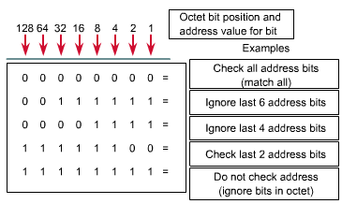
The Wildcard Mask
This table may help:

Slide 60
Masking Practice
Write an ip mask and wildcard mask to check for all hosts on the network: 192.5.5.0 255.255.255.0
Answer: 192.5.5.0 0.0.0.255
Notice that this wildcard mask is a mirror image of the default subnet mask for a Class C address.
WARNING: This is a helpful rule only when looking at whole networks or subnets.

Slide 61
Masking Practice
Write an ip mask and wildcard mask to check for all hosts in the subnet: 192.5.5.32 255.255.255.224
If you answered 192.5.5.32 0.0.0.31
0.0.0.31 is the mirror image of 255.255.255.224
Let’s look at both in binary:
11111111.11111111.11111111.11100000 (255.255.255.224)
00000000.00000000.00000000.00011111 (0.0.0.31)
To prove this wildcard mask will work, let’s look at a host address within the .32 subnet--192.5.5.55
11000000.00000101.00000101.00110111 (192.5.5.55) host address
11000000.00000101.00000101.00100000 (192.5.5.32) ip mask
00000000.00000000.00000000.00011111 (0.0.0.31) wildcard mask

Slide 62
Masking Practice
Notice some bits were colored blue. These bits are the bits that must match.
11000000.00000101.00000101.00110111 (192.5.5.55) host address
11000000.00000101.00000101.00100000 (192.5.5.32) ip mask
00000000.00000000.00000000.00011111 (0.0.0.31) wildcard mask
Remember: a “0” bit in the wildcard mask means check the bit; a “1” bit in the wildcard mask means ignore.
The “0”s must match between the address of the packet (192.5.5.55) being filtered and the ip mask configured in the access list (192.5.5.32)
Write an ip mask and wildcard mask for the subnet 192.5.5.64 with a subnet mask of 255.255.255.192?
Answer: 192.5.5.64 0.0.0.63

Slide 63
Masking Practice
Write an ip mask and wildcard mask for the subnet 172.16.128.0 with a subnet mask of 255.255.128.0?
Answer: 172.16.128.0 0.0.127.255
Write an ip mask and wildcard mask for the subnet 172.16.16.0 with a subnet mask of 255.255.252.0?
Answer: 172.16.16.0 0.0.3.255
Write an ip mask and wildcard mask for the subnet 10.0.8.0 with a subnet mask of 255.255.248.0?
Answer: 10.0.8.0 0.0.7.255

Slide 64
Masking a Host Range
You can also deny a portion of a subnet while permitting another.
To mask a range of host within a subnet, it is often necessary to work on the binary level.
For example, students use the range 192.5.5.0 to 192.5.5.127 and teachers use the range 192.5.5.128 to 192.5.5.255. Both groups are on network 192.5.5.0 255.255.255.0
How do you write an ip mask and wildcard mask to deny one group, yet permit another?

Slide 65
Masking a Host Range
Let’s write the masks for the students.
First, write on the first and last host address in binary. Since the first 3 octets are identical, we can skip those. All their bits must be “0”
First Host’s 4th octet: 00000000
Last Host’s 4th octet: 01111111
Second, look for the leading bits that are shared by both (in blue below)
00000000
01111111
These “bits in common” are to be checked just like the common bits in the 192.5.5 portion of the addresses.
Examples: Host Ranges 192.5.5.0 to .127 and .128 to .255

Slide 66
Masking a Host Range
Third, add up the decimal value of the “1” bits in the last host’s address (127)
Finally, determine the ip mask and wildcard mask
The ip mask can be any host address in the range, but convention says use the first one
The wildcard mask is all “0”s for the common bits
192.5.5.0 0.0.0.127
What about the teachers? What would be their ip mask and wildcard mask?
192.5.5.128 (10000000) to 192.5.5.255 (11111111)
Answer: 192.5.5.128 0.0.0.127
Notice anything? What stayed the same? changed?
Examples: Host Ranges 192.5.5.0 to .127 and .128 to .255

Slide 67
Again...
192.5.5.0 - 192.5.5.127
Students
11000000.00000101.00000101.00000000 -
11000000.00000101.00000101.01111111
00000000.00000000.00000000.01111111
Teachers
11000000.00000101.00000101.10000000 -
11000000.00000101.00000101.11111111
00000000.00000000.00000000.01111111
Wildcard stayed the same - the ip mask changed!
Ignore the last 7 bits of both the ip masks

Slide 68
Time Savers: the any command
Since ACLs have an implicit “deny any” statement at the end, you must write statements to permit others through.
Using our previous example, if the students are denied access and all others are allowed, you would write two statements:
Lab-A(config)#access-list 1 deny 192.5.5.0 0.0.0.127
Lab-A(config)#access-list 1 permit 0.0.0.0 255.255.255.255
Since the last statement is commonly used to override the “deny any,” Cisco gives you an option--the any command:
Lab-A(config)#access-list 1 permit any

Slide 69
Time Savers: the host command
Many times, a network administrator will need to write an ACL to permit a particular host (or deny a host). The statement can be written in two ways. Either...
Lab-A(config)#access-list 1 permit 192.5.5.10 0.0.0.0
or...
Lab-A(config)#access-list 1 permit host 192.5.5.10

Slide 70
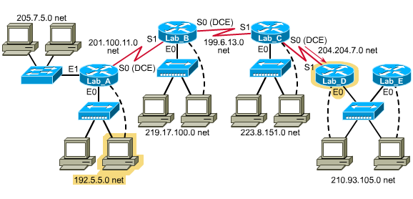
Correct Placement of Standard ACLs
Standard ACLs do not have a destination parameter. Therefore, you place standard ACLs as close to the destination as possible.
To see why, ask yourself what would happen to all ip traffic if you placed a “deny 192.5.5.0 0.0.0.255” statement on Lab-A’s E0?
router
Interface E0
Notes:
Distributed Computing Environment

Slide 71
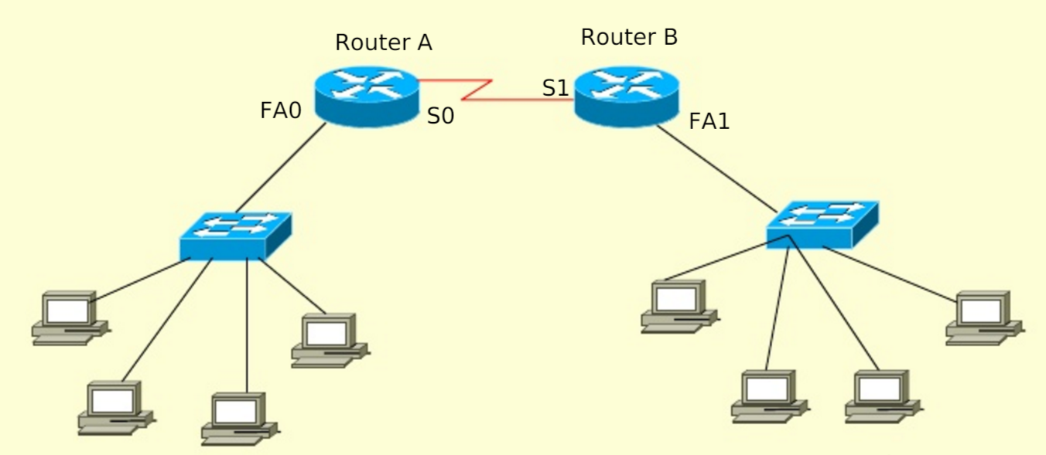
Placement of ACLs
Anne
Bob
Anne has been sending unnecessary information to Bob.
Where would you place the standard ACL to deny all traffic from Anne to Bob?
(Router B on FA1)
Notes:
Router B on FA1

Slide 72
Extended ACL Overview
Extended ACLs are numbered from 100 - 199 and “extend” the capabilities of the standard ACL.
Extensions include the ability to filter traffic based on...
destination address
portions of the ip protocol
You can write statements to deny only protocols such as “icmp” or routing protocols like “rip” and “igrp”
upper layers of the TCP/IP protocol suite
You can write statements to deny only protocols such as “tftp” or “http”
You can use an operator like eq, gt, lt, and neq (equal to, greater than, less than, and not equal to) to specify how to handle a particular protocol.
For example, if you wanted an access list to permit all traffic except http access, you would use permit ip any any neq 80

Slide 73
Two Basic Tasks (Extended ACL)
Write the ACL statements sequentially in global configuration mode.
Router(config)# access-list access-list-number {permit|deny} {protocol|protocol-keyword}{source source-wildcard} {destination destination-wildcard} [protocol-specific options] [log]
Lab-A(config)#access-list 101 deny tcp 192.5.5.0 0.0.0.255 210.93.105.0 0.0.0.255 eq telnet log
Group the ACL to one or more interfaces in interface configuration mode (same command syntax as standard)
Router(config-if)#{protocol} access-group access-list-number {in/out}
Lab-A(config-if)#ip access-group 101 out

Slide 74
The Extended Parameters
access-list-number
choose from the range 100 to 199
{protocol | protocol-number}
For the CCNA, you only need to know ip and tcp--many more are available
{source source-wildcard}
same as in standard
{destination destination-wildcard}
formatted like the standard, but specifies the destination
[protocol-specific options]
This parameter is used to specify particular parts of a protocol that needs filtering.

Slide 75
Port Numbers
Review the various port numbers for the tcp and udp protocols and know the most common ones below.
You can also simply type the name (telnet) instead of the number (23) in the {protocol-specific options}
Port Number | Description
21 | FTP
23 | Telnet
25 | SMTP
53 | DNS
69 | TFTP

Slide 76
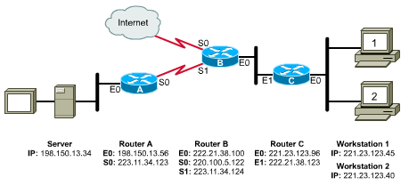
Correct Placement of Extended ACLs
Since extended ACLs have destination information, you want to place it as close to the source as possible.
Place an extended ACL on the first router interface the packet enters and specify inbound in the access-group command.

Slide 77
Correct Placement of Extended ACLs
In the graphic below, we want to deny network 221.23.123.0 from accessing the server 198.150.13.34.
What router and interface should the access list be applied to?
Write the access list on Router C, apply it to E0, and specify “in”
This will keep the network free of traffic from 221.23.123.0 destined for 198.150.13.34 but still allow 221.23.123.0 access to the Internet

Slide 78
Writing & Applying the ACL
Router-C(config)#access-list 100 deny ip 221.23.123.0 0.0.0.255 198.150.13.34 0.0.0.0
Router-C(config)#access-list 100 permit ip any any
Router-C(config)#int e0
Router-C(config-if)#ip access-group 100 in
Notes:
access-list access-list-number {permit|deny} {protocol|protocol-keyword} {source source-wildcard} {destination destination-wildcard}

